Slide 1
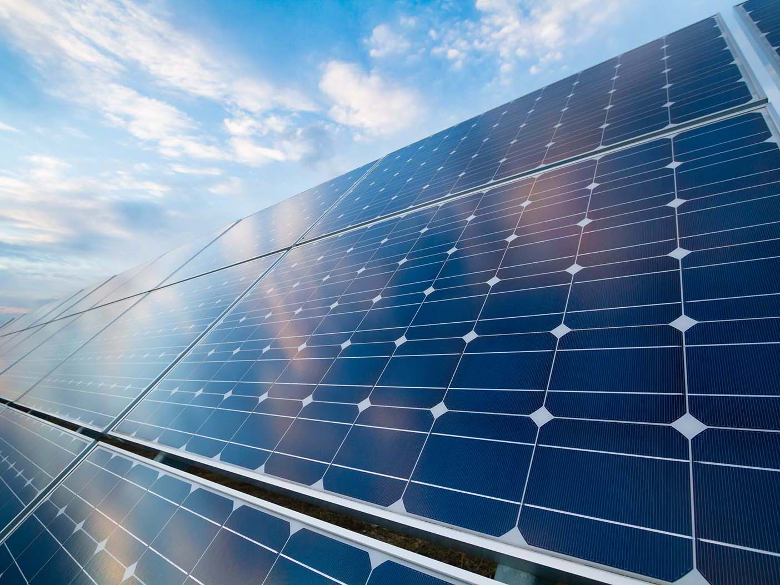

Team 16: Solar Power Battery
Bi-Weekly Update 5 Lauren Lugo, Tarik Dawson, Clement Ong, Nathan Gil Sponsor: Peng-Hao Huang TA: Dalton W. Cyr
Notes:
Michelle

Slide 2
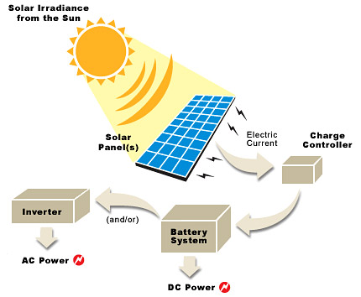
Project Summary
Problem Statement:
Provide the user with an independent solar power generating system that can charge both AC and DC devices
Solution proposal:
Develop independent power grid using a solar panel that can charge the majority of items throughout the day and night. Both AC and DC power provided.
Notes:
Kyle

Slide 3
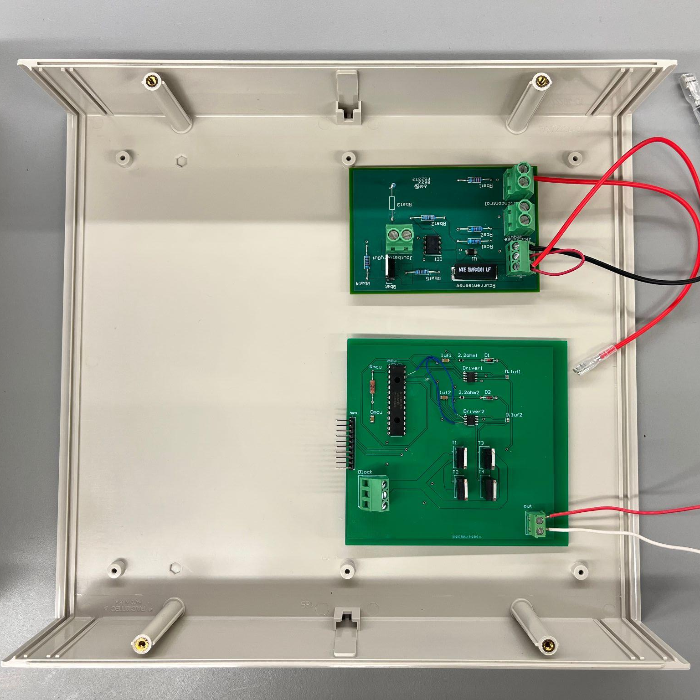
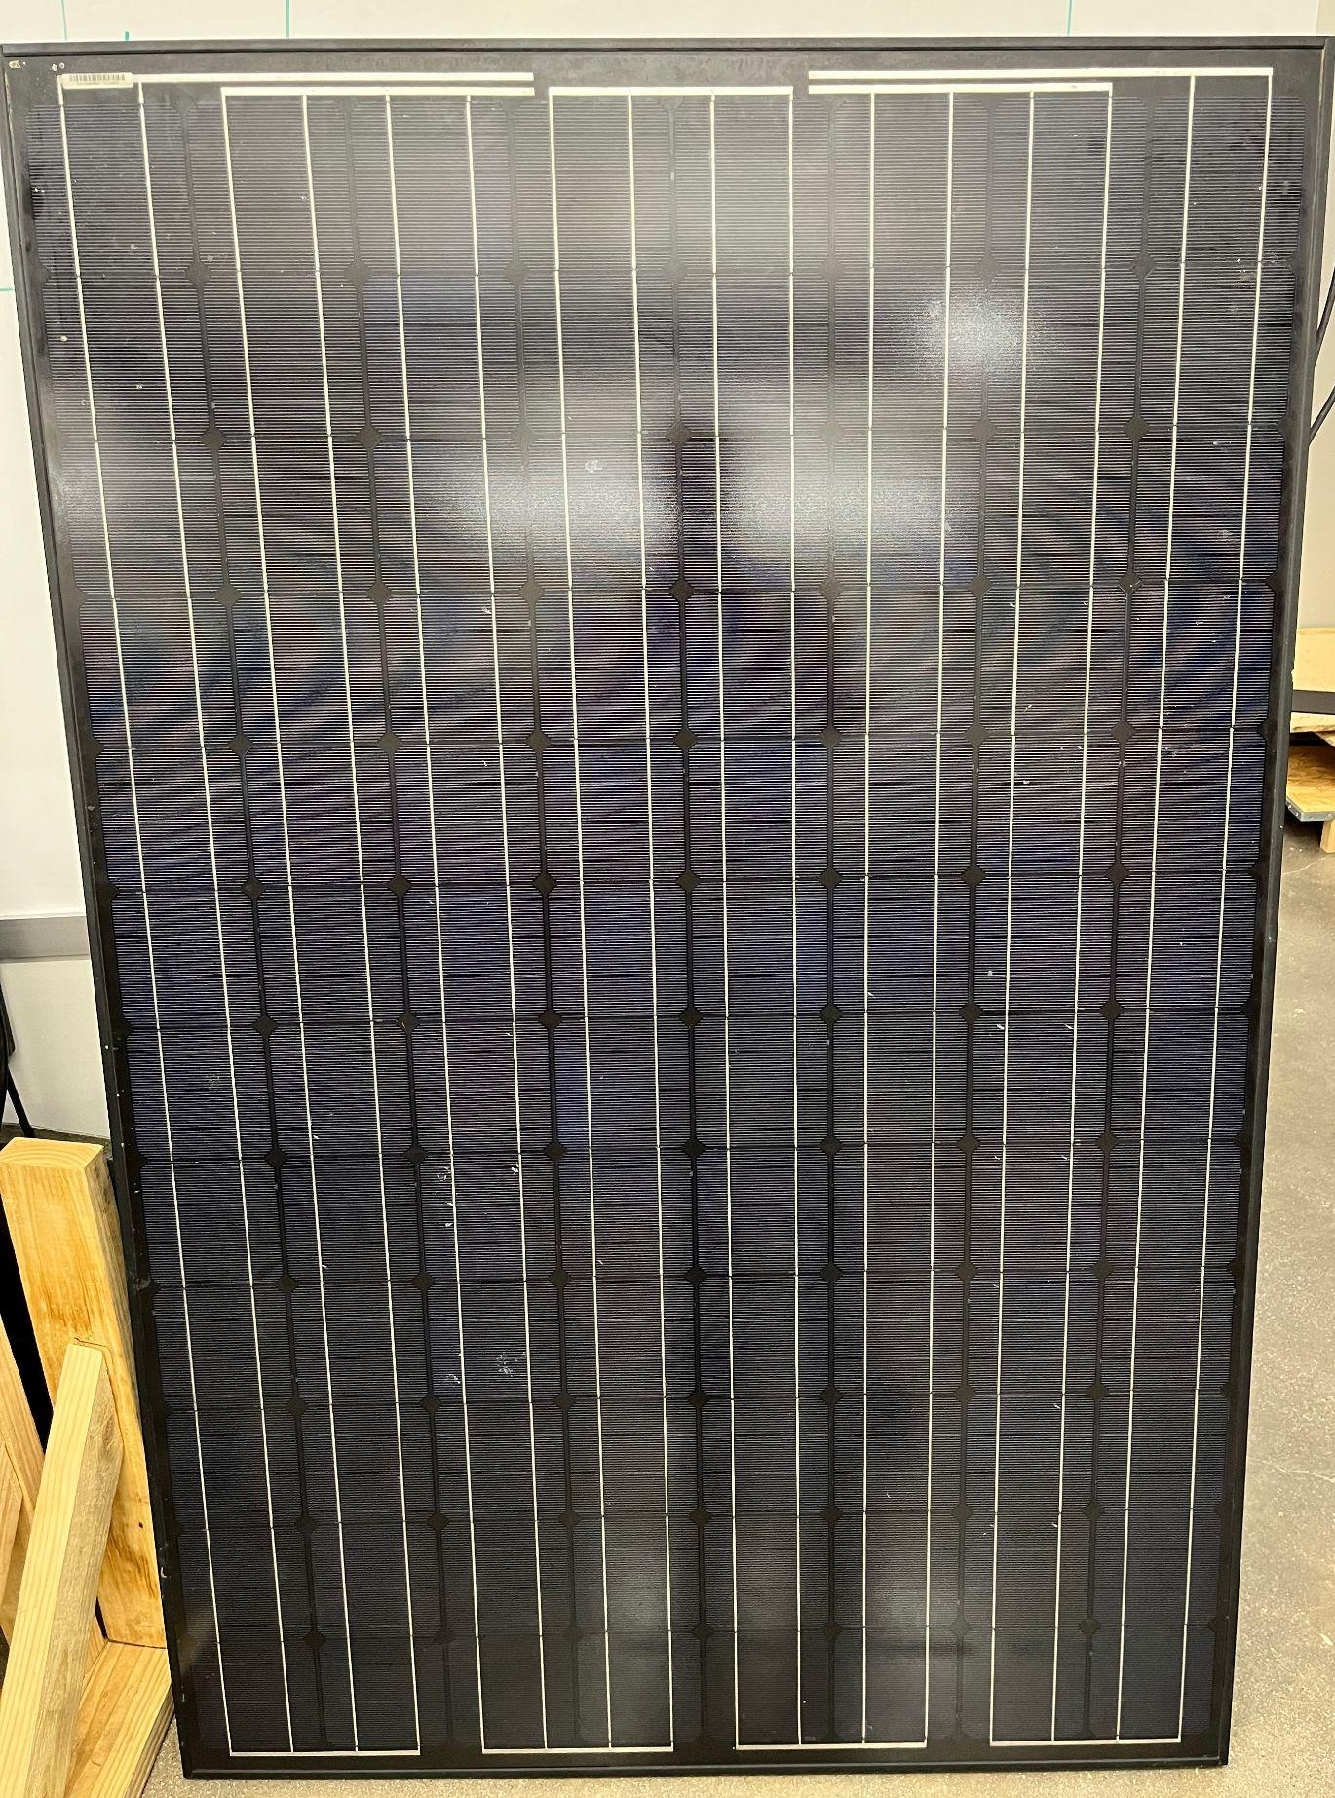
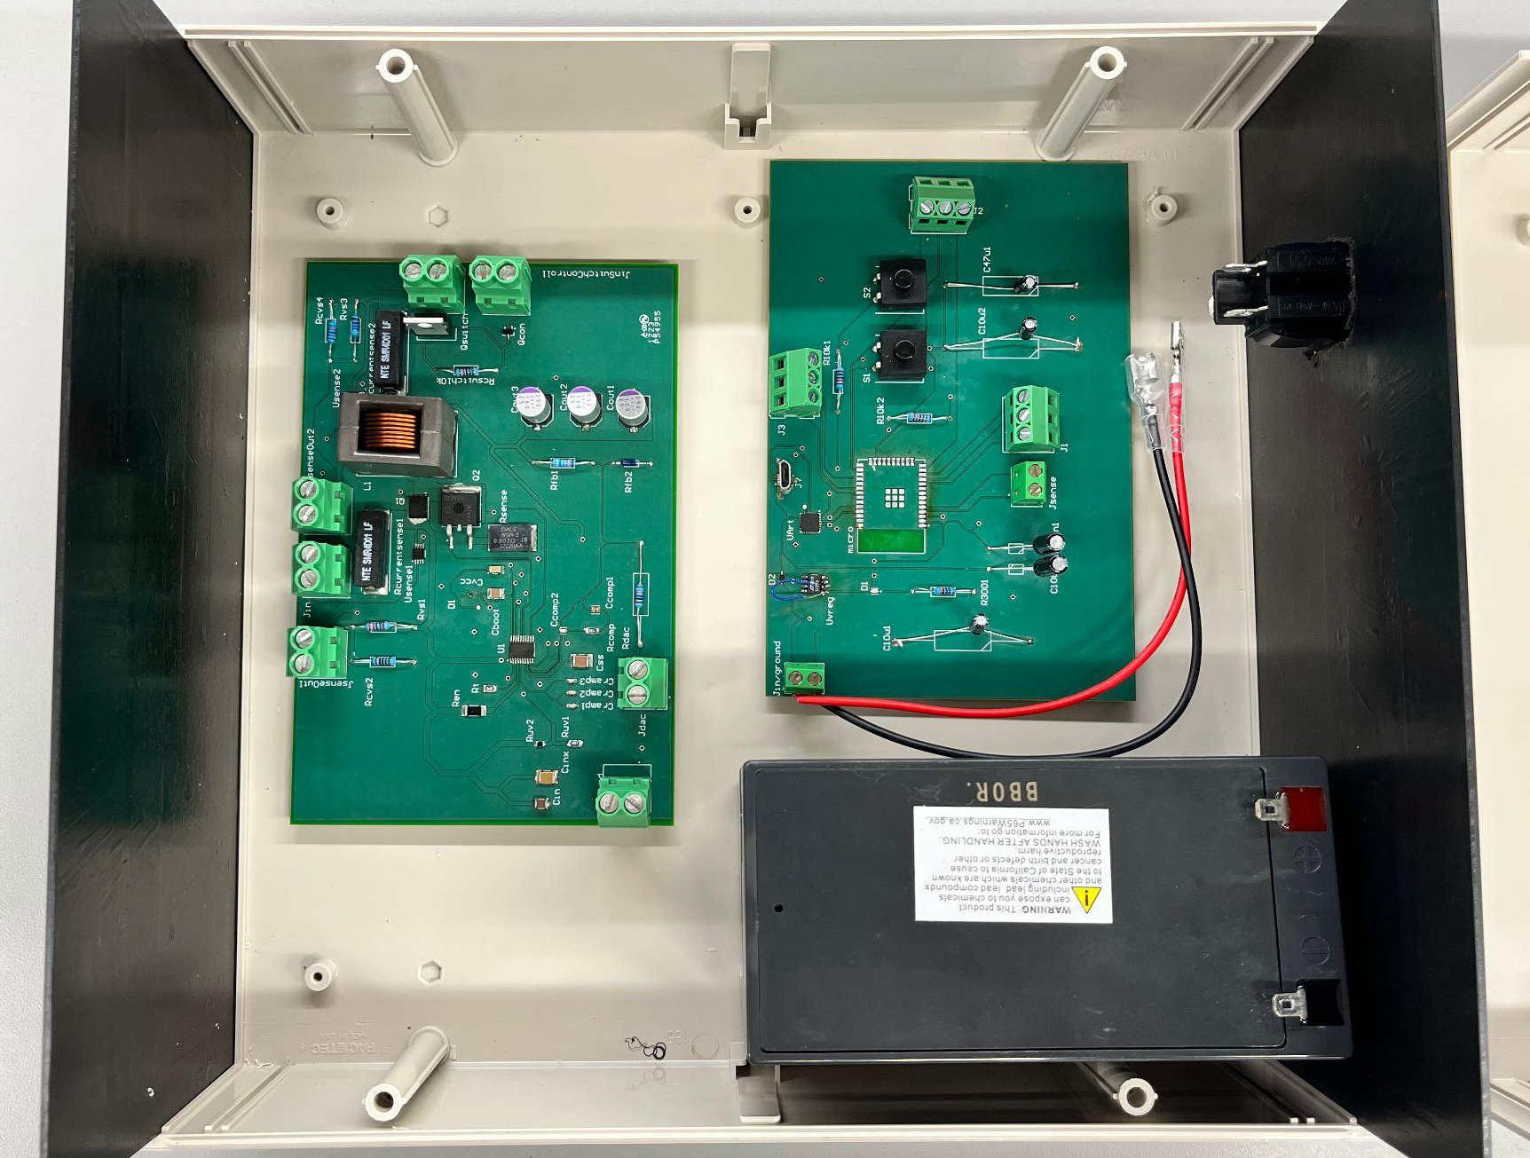
Integrated System Diagram
Top level
Solar Panel
Battery Sensor
DC-AC
Device
Bottom level
Microcontroller
Output ports
Battery
DC-DC
Notes:
Eric

Slide 4
Project Timeline
(Complete)
(Complete)
(Ongoing)
(Ongoing)
(Not Started)
Jan 18th - Feb 1st
Feb 2nd - Feb 28th
March 1st - April 7th
April 7th - April 21st
April 21st - April 28th
Finalize Subsystems
Validate Individual Subsystems
Integration Between Subsystems
Validate System
Final Demo
Team members have finalized their designs and making finishing touches on subsystem
Team will finalize and validate individual subsystems
ESP32 and Database is undergoing integration for bi-direction communication. Integration between DC-DC and ESP32.still ongoing
Through power (Solar) test plans in place.
Team will demo the final completed system
Notes:
Eric

Slide 5
MPPT
Accomplishments since last update 20 hrs of effort | Ongoing progress/problems and plans until the next presentation
New voltage regulator working properly | Adding a new ESP32 to the board today, after burning the old one Validate all code to ESP32 PCB board and connection to switch/sensors Integrate DC-DC converter board with ESP32, battery and battery switch/sensor boards together

Slide 6
DC-DC Converter
Tarik Dawson
Accomplishments since last update 18 hrs of effort | Ongoing progress/problems and plans until the next presentation
New board arrived, soldered and tested. Everything in working order. Tests partially complete Enclosure arrived and partially modified. | Further modify enclosure to include other ports Continue validation tests Connect Solar Panel and conduct field test/through power solar test

Slide 7
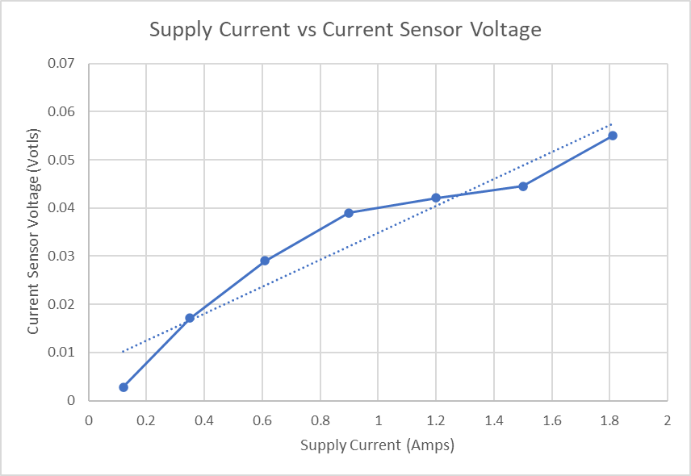
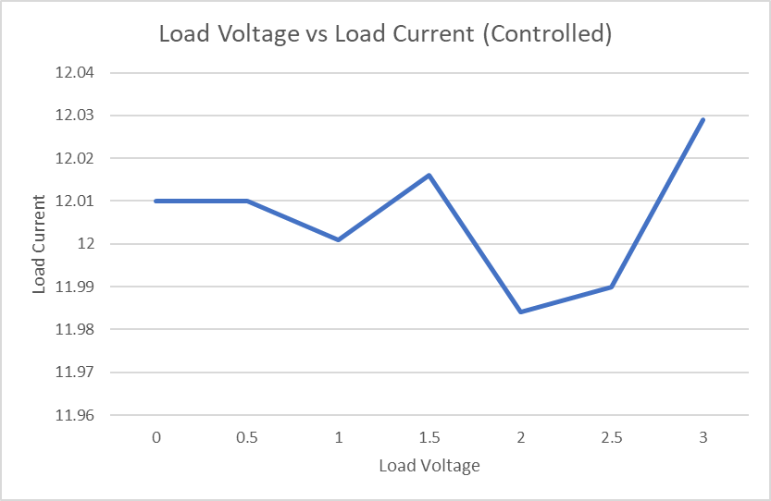
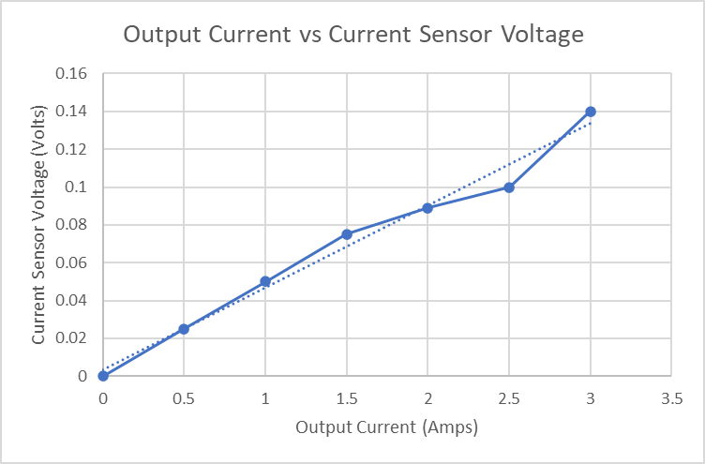
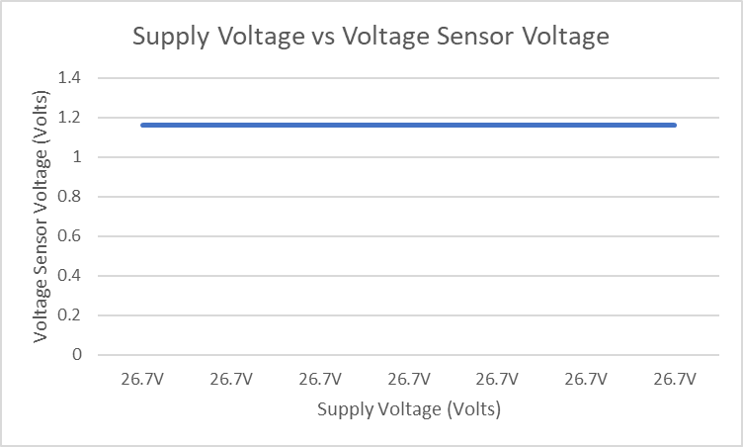
DC-DC Converter

Slide 8
DC-AC Inverter
Accomplishments since last update 23 hrs of effort | Ongoing progress/problems and plans until the next presentation
Resolved smoking MOSFET problem Validated inverter operation and output without transformer connected Touched up PCB design with minor changes | Significant power loss when connected to transformer Test inverter system with DC-DC Converter system

Slide 9
DC-AC Inverter
Inverter produces AC output
Output waveform (without transformer) is as expected
Modified sine wave, expected amplitude and frequency
Vin = 12V, Vout = 10.96V
Current problems:
Significant power loss when connected to transformer
Vin set at 12V, drops to 6.3V
Vout = 27.65V
Plans:
Test with larger deadband gap in PWM wave
Test and validate with other subsystems

Slide 10
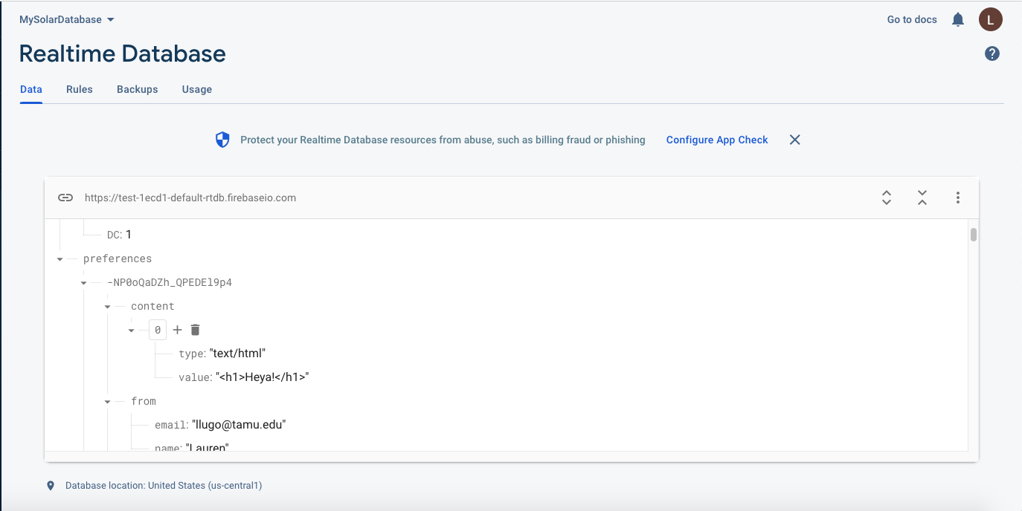

Website / Android Application
Accomplishments since last update 17 hrs of effort | Ongoing progress/problems and plans until the next presentation
Replicated ESP32 environment / code on local laptop Able to complete first testbench (sending data to backend database) | Redesign code for final system integration Validate ESP32 for consistency with large amounts of data being sent (Website / App has already been validated - just needed backend data)

Slide 11
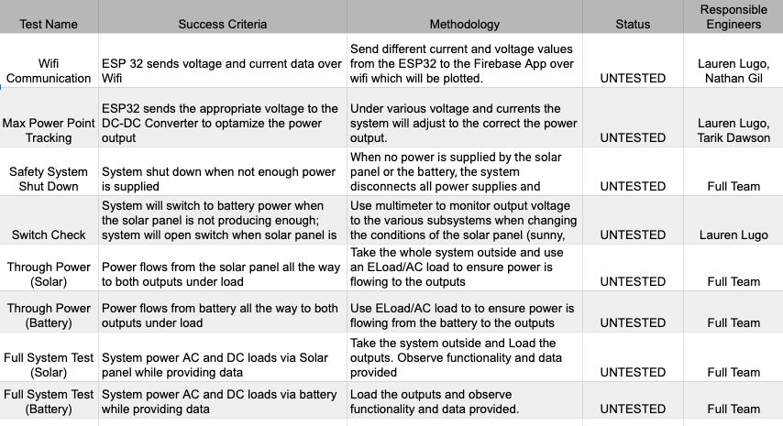
Validation Plan

Slide 12
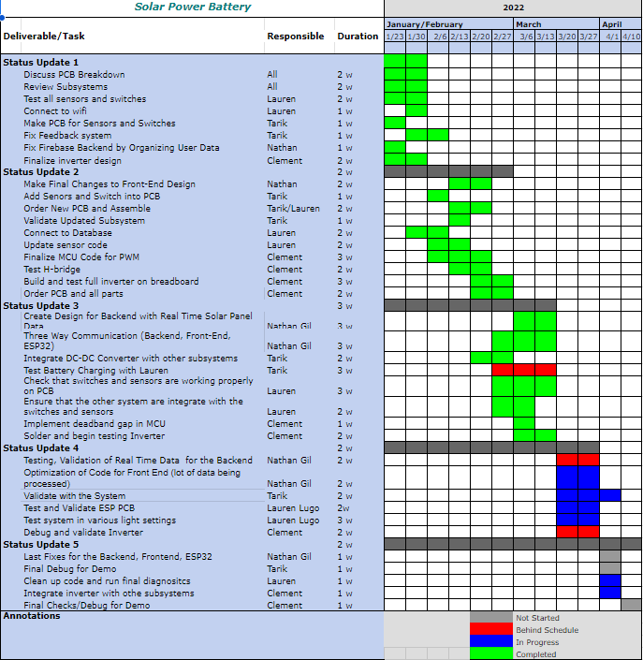
Execution Plan

Slide 13
Thank You!
Questions?

